Slide 1
S2U1L2 Ming Dynasty
Aim: Did Isolation help or hurt China’s development?

Slide 2
DO NOW – 10 Minutes.
Using Document D and your Graphic Organizer to complete information for the Indian Ocean

Slide 3
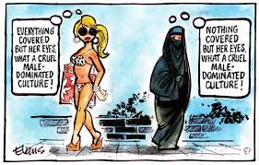
AIM: Did isolationism help or hurt China’s Development?
What is the perspective of each woman? Left:
Right: Why do you think these women don’t agree?

Slide 4
Document Note Catcher
Document/Topic | Comprehension Question | Isolation/Interaction? | Grade + Explanation
A: Technological Advances | What were two accomplishments of the Ming Dynasty? - - Why were these accomplishments possible?

Slide 5
Advancements/Accomplishments of the Ming Dynasty
Advancements/Achievements of the Ming Dynasty Great Wall Zheng He Voyages Printing and literature Book on Traditional Chinese Medicine Forbidden City Encyclopedia Written in 1403 Porcelain Pagoda Ceramics Agricultural reforms led to a huge surplus

Slide 6
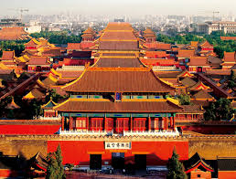
Forbidden City

Slide 7
Document A: Technological Advances
In 1368, the Mongol dynasty fell and the Ming emperors gained power. During the Ming dynasty, China enjoyed nearly three hundred years of stability and prosperity. Ming emperors expanded the Chinese empire to include Korea, Burma, and Vietnam. The Ming constructed a magnificent Imperial palace in Beijing, known as the Forbidden City, which became home to all later Chinese emperors. In addition, art and literature flourished in Ming China. Trade prospered. The Ming even sponsored great naval expeditions, such as the voyages of Zheng He to India, Arabia, and Africa in the early 1400s.

Slide 8
Document Note Catcher
Document/ Topic | Comprehension Question | Isolation/Interaction? | Grade + Explanation
B: Zheng He Voyages | List 2 accomplishments from Zheng He’s voyages: - - What ended the Chinese “Age of Exploration”?

Slide 9
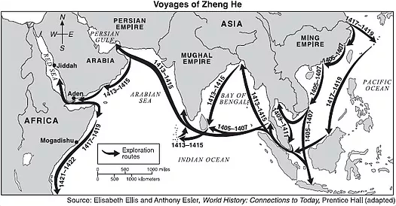

Slide 10
In the early 1400s, Zheng He led the largest ships in the world on seven voyages of exploration to the lands around the Indian Ocean, demonstrating Chinese excellence at shipbuilding and navigation.
Zheng He's first voyage lasted from 1405 to 1407. He traveled all the way to Calicut, India visiting many towns and ports along the way. They traded and made diplomatic relations at the places they visited. Zheng He would continue to sail on additional missions over the rest of his life. He traveled to many far away places, going all the way to the African coast and establishing trade relations with over 25 countries. He brought back all sorts of interesting items including animals such a giraffe and camels. He also brought back diplomats from various countries to meet with the Chinese Emperor.
After the final voyage, the Chinese emperor suddenly ordered that these expensive expeditions be halted. The ships were left to rot in the harbors, and craftsmen forgot how to build such large ships, letting the knowledge slip away.

Slide 11
Document Note Catcher
Document/Topic | Comprehension Question | Isolation/ Interaction? | Grade + Explanation
C: Great Wall | What was the physical purpose of the Great Wall of China? What other purpose did the Great Wall serve?

Slide 12
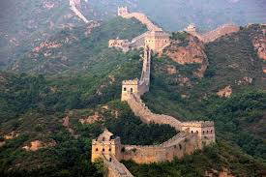
Document C: Great Wall of China

Slide 13
The Great Wall of China actually consists of numerous walls and fortifications, many running parallel to each other. It was constructed as a means of preventing incursions from barbarian nomads into the Chinese Empire, the wall is one of the most extensive construction projects ever completed.
Despite its long history, the Great Wall of China as it is exists today was constructed mainly during the mighty Ming dynasty (1368-1644). Under the strong hand of the Ming rulers, Chinese culture flourished, and the period saw an immense amount of construction in addition to the Great Wall, including bridges, temples and pagodas.
After an initial phase of territorial expansion, Ming rulers took a largely defensive stance, and their reformation and extension of the Great Wall was key to this strategy.
Though the Great Wall never effectively prevented invaders from entering China, it came to function more as a psychological barrier between Chinese civilization and the world, and remains a powerful symbol of the country’s enduring strength.

Slide 14
Document Note Catcher
Document/Topic | Comprehension Question | Isolation/ Interaction? | Grade + Explanation
D: Ethnocentrism | Why did the Chinese begin to isolate themselves? How did the practice of isolationism affect China and the Ming Dynasty?

Slide 15
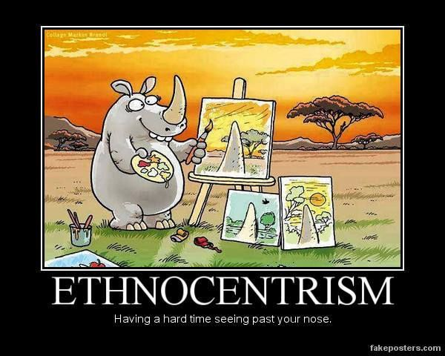

Slide 16
Document D: Ethnocentrism
The Chinese elite looked down upon Europeans and other foreigners. They believed that foreigners lacked the civilized ways of the “Middle Kingdom” or China. This belief in one’s own cultural superiority is known as ethnocentrism.
In the 1500s, the Ming emperors began to isolate China from other countries. They decided to keep foreigners out and the Chinese in. Isolation kept the Chinese from learning exciting new things happening elsewhere.
During the 1500s, the Chinese did little traveling or trading. China began to change. It had been ahead of other civilizations, but isolation caused it to fall behind.
Towards the end of the Ming Dynasty, corruption among public officials weakened the dynasty. Eventually, the Ming lost the Mandate of Heaven or right to rule.

Slide 17
II: Short Response (10 Min)
a. How did the Chinese engage in cultural diffusion (sharing of cultures, goods, ideas, etc)?
b. Why did the Chinese stop foreign voyages and trade?

Slide 18
Exit Ticket: (10 Min)
Which foreign policy was better for the Ming Dynasty: Isolation or Interaction?
Use evidence to support your answer.
EXCELLENT Argues a side accurately using relevant information in the written statement that demonstrates a clear and detailed understanding of the effects of isolation on China. Accurately and clearly gives two or more examples counter arguing of the effects of isolation on China. Uses key words accurately. Product is creative, accurate, and complete. | GOOD Argues a side using relevant information in the written statement that demonstrates an understanding of the effects of isolation on China. Has a counter argument about the effects of isolation on China. Uses key words in which most are accurately used. Product is complete and creative. | SATISFACTORY Argues a side Uses supporting details that are relevant, but limited, general, or inconsistent in the written statement about the effects of isolation on China. Counter argument about the effects of isolation on China is unclear. Does not use key words and/or does not display a clear understanding of the definition. Product is complete. | UNSATISFACTORY Does not argue a side and or does not argue a side accurately. There are minimal details and/or details given are not accurate about the effects of isolation on China. Does not accurately present a counter argument. Key words are not used or inaccurate. Product is incomplete.

